Slide 1
Compare and Contrast Essays

Slide 2
What are Compare and Contrast Essays?
To compare
Is to look for similarities
To contrast
Is to find differences

Slide 3
What you can compare and contrast?
Theories
Methods
Ideas
Historical periods
Characters (for example, in a novel)

Slide 4
How do you structure your essay?
Block
Point-by-point

Slide 5
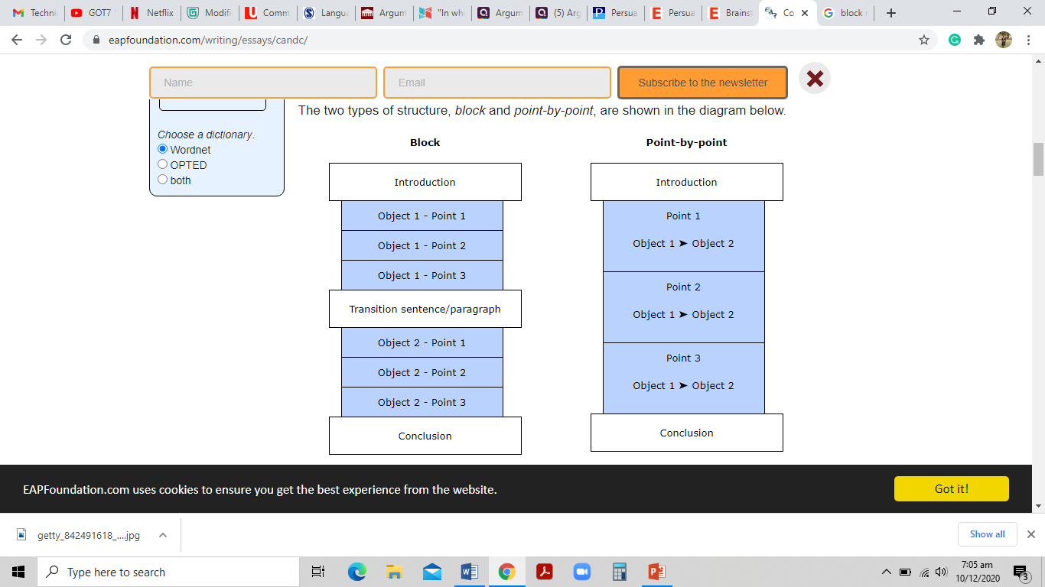

Slide 6
Transitional signals for compare and contrast
Compare
Contrast
Similarly
Likewise
also
both... and...
not only... but also...
neither... nor...
just like (+ noun)
similar to (+ noun)
to be similar (to)
to be the same as
to be alike
to compare (to/with)
However
In contrast
In comparison
By comparison
On the other hand
while
whereas
but
to differ from
to be different (from)
to be dissimilar to
to be unlike

Slide 7
Example for Comparison
“Computers can be used to communicate easily, for example via email. Similarly/Likewise, the mobile phone is a convenient tool for communication.”
Both computers and mobile phones can be used to communicate easily with other people.
Just like the computer, the mobile phone can be used to communicate easily with other people.
The computer is similar to the mobile phone in the way it can be used for easy communication.

Slide 8
Example for contrast
“Computers, although increasingly small, are not always easy to carry from one place to another. However, the mobile phone can be carried with ease.”
Computers are generally not very portable, whereas the mobile phone is.
Computers differ from mobile phones in their lack of portability.
Computers are unlike mobile phones in their lack of portability.

Slide 9
Read the following example, is it stated right or wrong?
Aaron is tall and strong. In contrast, Bruce is handsome and very intelligent.

Slide 10
Point to be noted
While writing similarities or differences between two things, decide on your criteria,
For example:
Aaron is tall and strong. In contrast, Bruce is handsome and very intelligent does not fall in to the same criteria.
Aron | Bruce
He is tall | He is handsome
He is strong | He is intelligent

